Slide 1

Luxembourg Development Analysis
By Tudor Sclifos, IS-251M
Data Source: Eurostat

Slide 2
Methodology
1
2
3
Data Collection
Data Cleaning
Transformation
14 indicators from Eurostat across categories
Outlier detection, temporal alignment
Z-score normalization, aggregation
4
5
6
Analysis
Interpretation
Validation
Univariate, bivariate, multivariate and correlation analysis
Pattern identification and
Pearson & Spearman comparison

Slide 3
Research Questions
How has inflation-unemployment relationship evolved?
1
What's the link between GDP and health outcomes?
2
How do unemployment rates affect emigration patterns?
3

Slide 4
Data Indicators
12 indicators analyzed from Eurostat (2 excluded)
DEMOGRAPHIC (5)
ECONOMIC (6)
Population, Emigration, Immigration, Life Expectancy, Deaths
Inflation, GDP, Consumption, Exports, Imports, Current Account
EXCLUDED (2)
LABOR MARKET (1)
Job Vacancies, House Prices
Unemployment Rate
Insufficient historical data (<20 years)

Slide 5
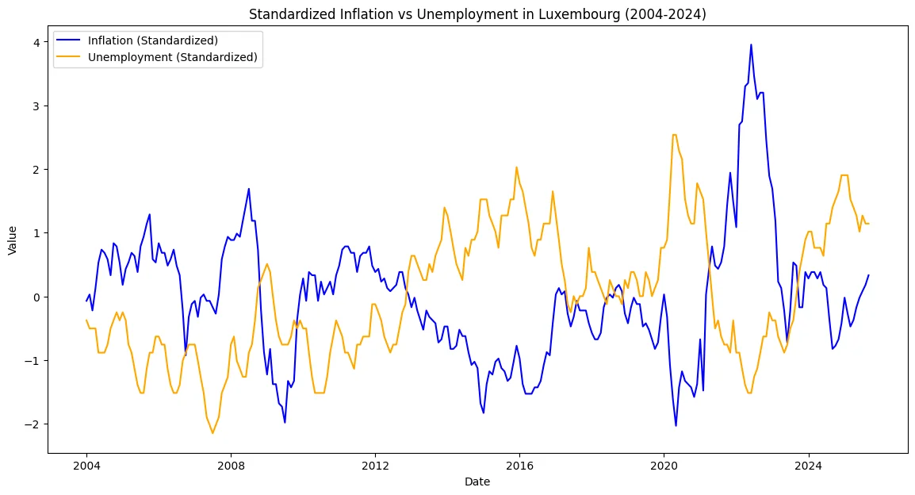
Inflation vs Unemployment
Negative correlation (-0.43 Spearman Correlation) (2004-2024)

Slide 6
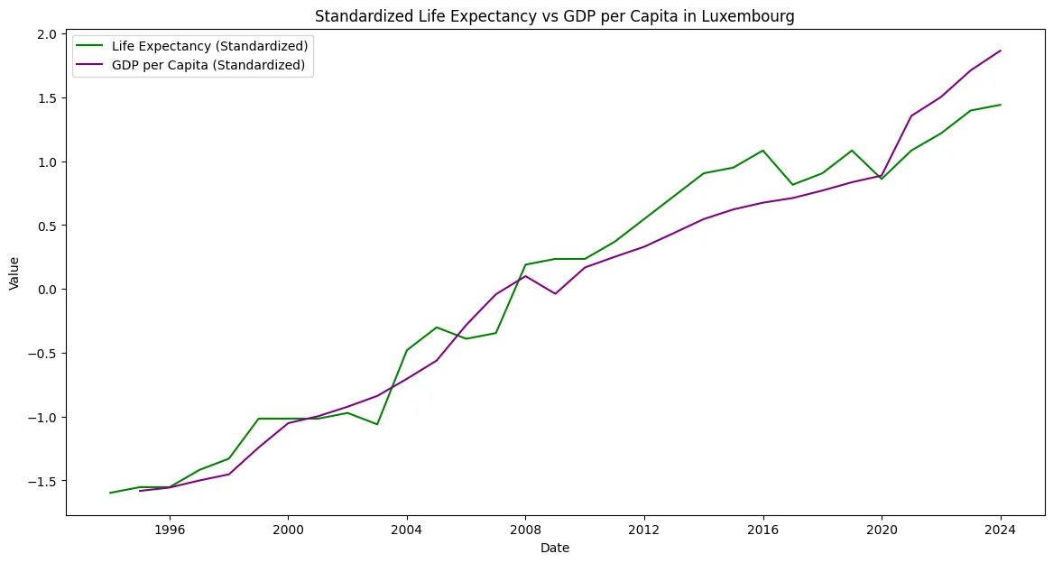
Prosperity & Health
Strong positive correlation (0.95 Pearson Correlation) (1994-2024)

Slide 7
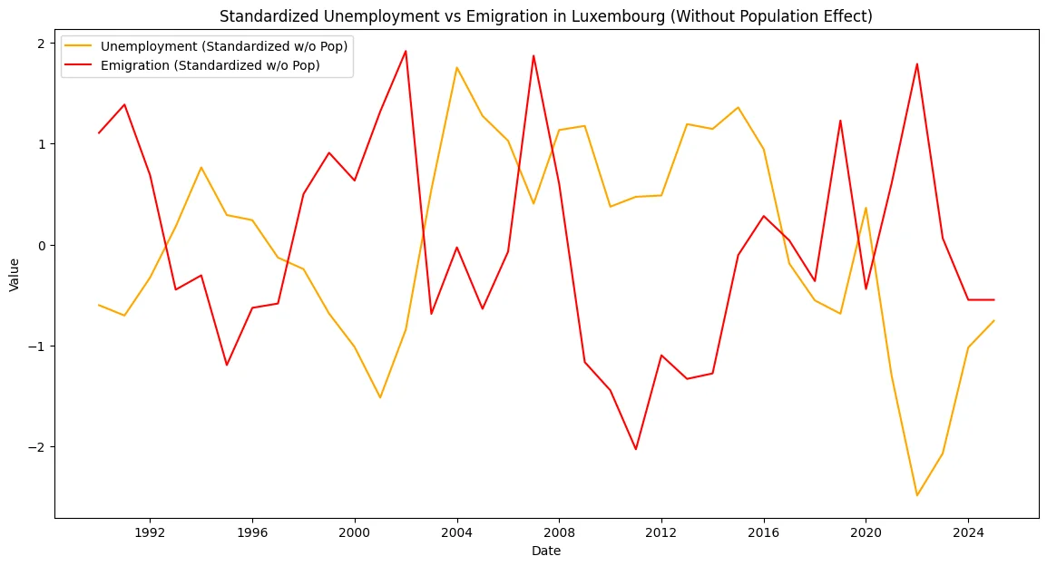
Unemployment & Emigration
Counterintuitive negative relationship (after removing the population trend)

Slide 8
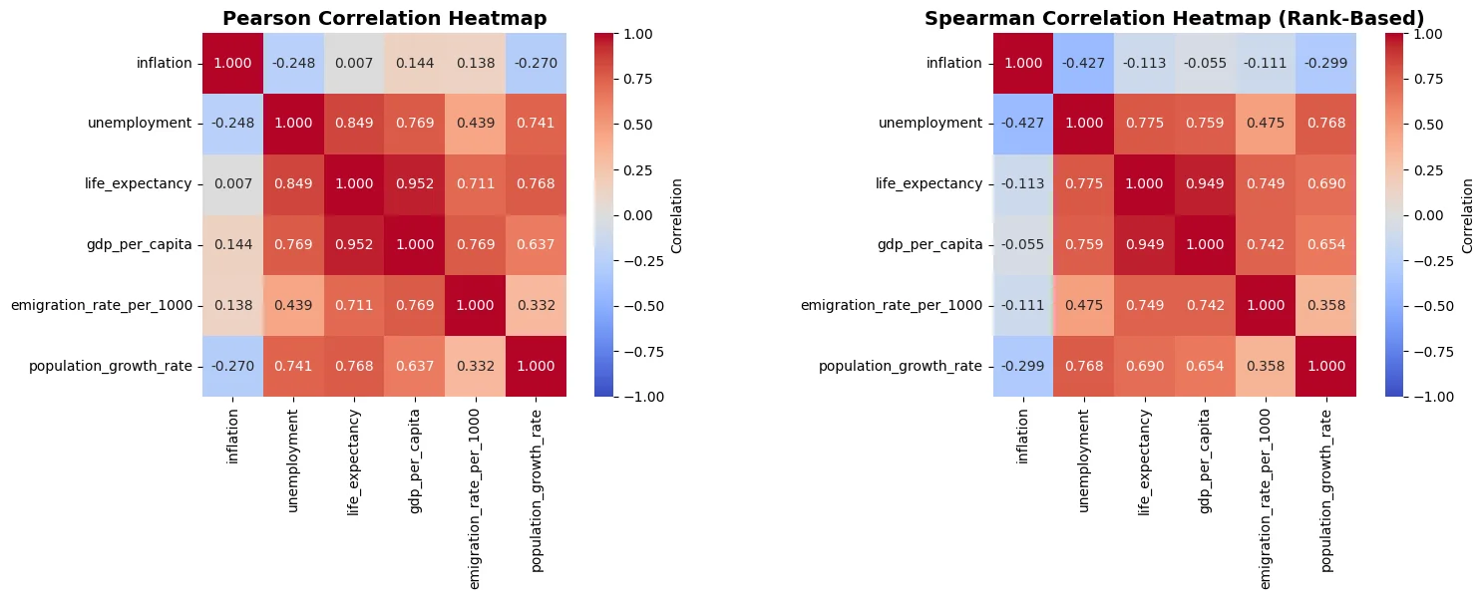
Correlation Analysis
Strongest relationships: Life expectancy, GDP, and unemployment

Slide 9
Key Findings
6x GDP Growth vs 2.3x Population Growth
Distinct Unemployment Regimes
From €3.8B to €22.9B
Two distinct regimes: 1-3% and 5-7%
Jobless Growth
Resilient Healthcare
GDP-Unemployment r = 0.77
Life expectancy at ~83 years VS EU at ~81.7
Immigration Driven
Inflation Independence
17K in vs 10K out annually
Weak correlations with other factors

Slide 10
Conclusions
Successful Development Model
Economic prosperity translates to improved health outcomes
Sustainability Challenges
Jobless growth and potential brain drain require policy attention
Small Economy Resilience
Strategic positioning enables sustained prosperity despite small country size

